Slide 1
App Review Analysis
App Review Analysis For Google Play store and App Store

Slide 2
The problem
Company
Context
Problem statement
We are the Marketing consultancy firm
We want to designs operating systems and want to build a major apps store into user interface.
For that we want to know whether Google Play apps have higher reviews on average than Apple Store apps (or vice versa) as we intending to strike a deal with just one of these companies.

Slide 3
Solution
We are going to collect data for app rating and going to check that which app store will be the best option for us. We are checking that Did Apple Store apps receive better reviews than Google Play apps? (or vice versa)
Analysing the Data

Slide 4
Implementation

Slide 5
Process we are gonna follow
Sourcing and loading
Cleaning and transforming
Modelling
Loading Data
We are collecting the data from kaggle from the latest survey on the Google and App Store Data.
Cleaning and Structuring
Cleaning and structuring the data is the most important part. Where we remove invalid data from the data set and make it usable.
Modelling
After getting proper structure of the data we are working on some statistical test to get the answer of our problem.

Slide 6
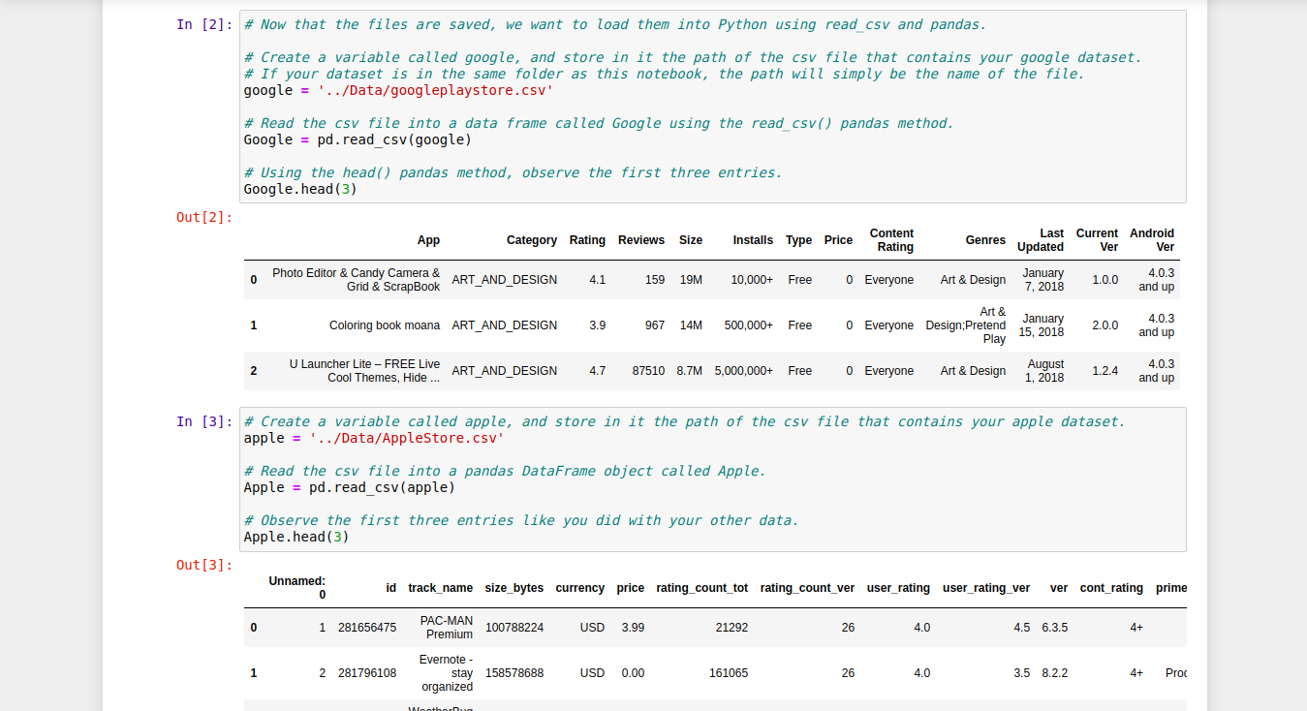
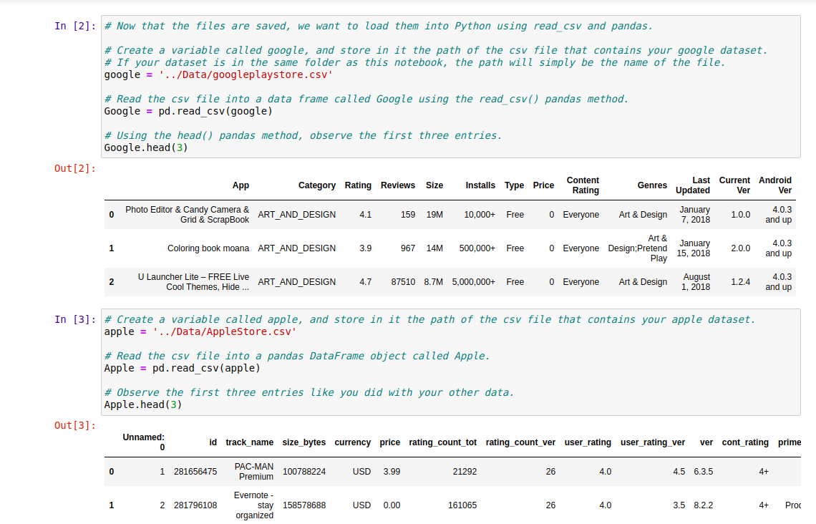
Sourcing and loading

Slide 7
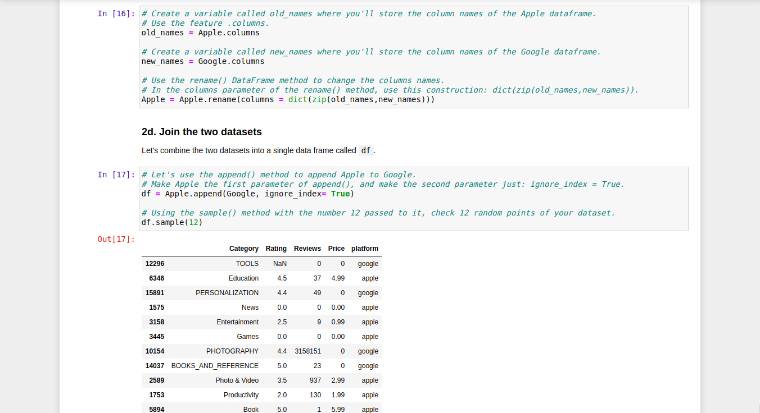
Cleaning, transforming and visualizing

Slide 8
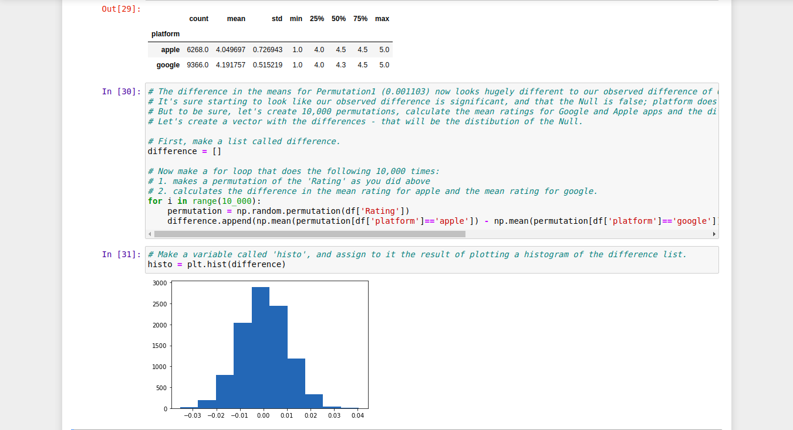
Modelling

Slide 9
Recommendation
After analysing and performing lots of test we came to the result is “platform does impact on ratings of the apps” and “Google Play apps receive better reviews than Apple Store apps.”

